Slide 1
Comparative Analysis of Machine Learning and Deep Learning Models for DDoS Attack Detection in Network Security

Slide 2


The aim of this research is to compare and evaluate machine learning and deep learning models for the detection and mitigation of DDoS attacks in network environments. The study seeks to identify the most efficient algorithm that enhances anomaly detection accuracy, minimizes false positives, and ensures a scalable, adaptive, and robust network security framework.

Slide 3

About (Distributed Denial-of-Service) Attacks :
Definition: A DDoS attack is a malicious attempt to disrupt normal traffic by overwhelming a target system, server, or network with excessive traffic from multiple sources.
Purpose: Attackers aim to exhaust network resources, making services unavailable to legitimate users.
Attack Mechanism: Uses a botnet (a network of compromised devices) to send massive amounts of fake traffic.
Types of DDoS Attacks:
Volume-Based Attacks: Flood the network with excessive traffic.
Protocol Attacks: Exploit vulnerabilities in network protocols.
Application Layer Attacks: Target specific applications or services.
Impact: Causes downtime, financial losses, and reputational damage for organizations.
Notes:
DDoS (Distributed Denial of Service) attacks are one of the biggest cybersecurity threats today. They flood a network or server with too much traffic, making it slow or completely unavailable to real users.
How Do DDoS Attacks Work?
Hackers use botnets (a network of infected devices) to send massive amounts of requests to a target.
The system gets overwhelmed and stops responding properly.
Types of DDoS Attacks
Volume-Based Attacks → Flood the network with data to slow it down.
Protocol Attacks → Exploit weaknesses in network communication.
Application-Layer Attacks → Target specific applications, like websites or online services.
Impact of DDoS Attacks
Financial Losses → Businesses lose money when services go down.
Reputational Damage → Customers lose trust if a company cannot protect its systems.

Slide 4
Mitigation refers to the process of detecting, preventing, and reducing the impact of cyber threats, such as DDoS attacks, to ensure the availability, integrity, and performance of network systems. It involves a combination of proactive and reactive strategies to minimize disruptions and maintain security.
Mitigation Techniques:
Traffic Filtering: Identifies and blocks malicious requests.
Rate Limiting: Controls the number of requests from a single source.
Anomaly Detection: Uses machine learning and AI to detect unusual traffic patterns.
Firewalls and Intrusion Prevention Systems (IPS): Prevents unauthorized access.
Role of Machine Learning & AI: Improves real-time detection and mitigation by learning attack patterns and minimizing false positives.
Notes:
How Can We Prevent DDoS Attacks?
Traffic Filtering → Blocking suspicious traffic.
Rate Limiting → Restricting how many requests a user can send.
Firewalls → Protecting networks from harmful traffic.
The Role of Machine Learning & AI
Traditional security methods often fail to keep up with new attack strategies. AI and Machine Learning can: ✅ Detect unusual traffic patterns in real time. ✅ Block attacks before they cause damage. ✅ Reduce false alarms and improve network security.
💡 Conclusion: Machine learning is a powerful tool for fighting DDoS attacks, making cybersecurity smarter and more effective.

Slide 5
Why is Mitigation Important?
Ensures Service Availability – Prevents downtime and keeps online services accessible to legitimate users.
Reduces Financial Losses – Businesses can lose revenue due to service disruptions caused by cyberattacks.
Protects Reputation – Frequent attacks and downtime can damage an organization's trust and credibility.
Prevents Resource Exhaustion – Ensures that network, server, and computational resources are not overwhelmed by malicious traffic.
Enhances Security Posture – Strengthens network defenses against evolving cyber threats.
Minimizes Operational Disruptions – Helps organizations maintain smooth and continuous operations.
Reduces False Positives – Advanced mitigation techniques, such as machine learning, improve detection accuracy while minimizing disruptions to legitimate traffic.
Notes:
Definition of Mitigation
Mitigation refers to the process of detecting, preventing, and reducing the impact of cyber threats, particularly DDoS attacks.
It ensures that networks and services remain operational, secure, and resilient against malicious traffic.
Why is Mitigation Important?
Ensures Service Availability:
DDoS attacks can overwhelm a network, making websites and applications inaccessible.
Proper mitigation prevents service disruptions and maintains uptime.
Reduces Financial Losses:
Prolonged downtime due to attacks can result in lost revenue and higher recovery costs.
Businesses, especially e-commerce and financial platforms, suffer significant financial damage.
Protects Reputation:
Frequent downtime and security breaches can erode customer trust and damage brand credibility.
Organizations must have strong mitigation strategies to maintain their reputation.
Prevents Resource Exhaustion:
DDoS attacks flood networks with malicious traffic, consuming bandwidth, CPU, and memory.
Mitigation ensures that these resources are allocated efficiently to handle legitimate users.
Enhances Security Posture:
Cyber threats are evolving, and traditional security measures are not enough.
Mitigation integrates AI-driven detection, traffic filtering, and anomaly-based monitoring for improved security.
Minimizes Operational Disruptions:
Enterprises rely on real-time data and online services for business continuity.
Mitigation strategies ensure smooth operations even under attack.
Reduces False Positives:
Some security solutions mistakenly flag legitimate traffic as malicious.
Advanced machine learning models can differentiate between normal and attack traffic, reducing disruptions to genuine users.

Slide 6
Literature Review
Existing Studies:
Various ML and DL techniques have been used, including SVM, Random Forest, LSTM, CNN, and hybrid approaches.
Datasets like UNSW-NB15, NSL-KDD are commonly used.
Papers.xlsx
Gaps Identified:
High false positive rates.
Scalability and adaptability challenges.
Need for real-time and efficient detection methods.

Slide 7
Datasets Used:
UNSW-NB15, NSL-KDD
Algorithms Considered:
Machine Learning: SVM, Random Forest, XGBoost
Evaluation Metrics:
Accuracy, Precision, Recall, F1-score, AUC-ROC
GitHub repository for network Anomaly
Expected Outcomes
Identification of the most effective ML/DL model for DDoS attack detection.
Improved detection rates with reduced false positives.
A scalable and adaptive solution for real-world network environments.

Slide 8
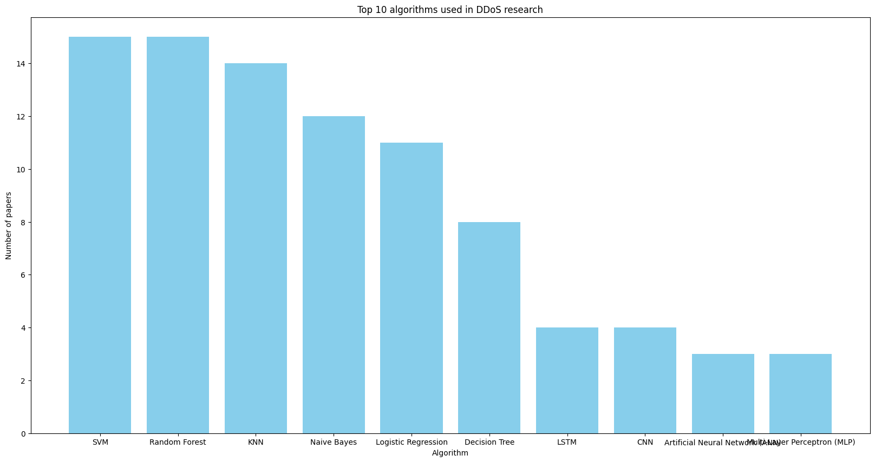
Top algorithms used in the literature.
Notes:
Traditional machine learning models like SVM, Random Forest, and KNN dominate DDoS detection research due to their proven accuracy and computational efficiency.However, deep learning models, particularly LSTM and CNN, are emerging as powerful tools for complex attack pattern recognition.The trend suggests a gradual shift towards hybrid approaches that combine traditional ML and deep learning for improved accuracy and real-time detection.

Slide 9
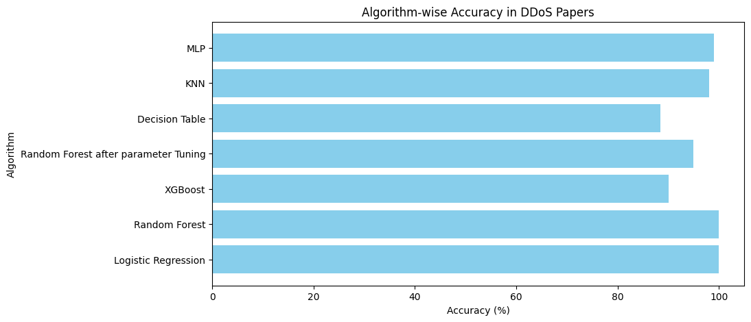
Top algorithms with its accuracy used in the literature.
Notes:
Random Forest, Logistic Regression, and MLP are among the most effective models for DDoS detection, achieving near-perfect accuracy.
Tuning parameters in models like Random Forest can significantly enhance performance.
XGBoost remains competitive, showing strong accuracy while being optimized for high performance.
Selecting the right algorithm depends on the dataset size, complexity, and computational constraints.

Slide 10
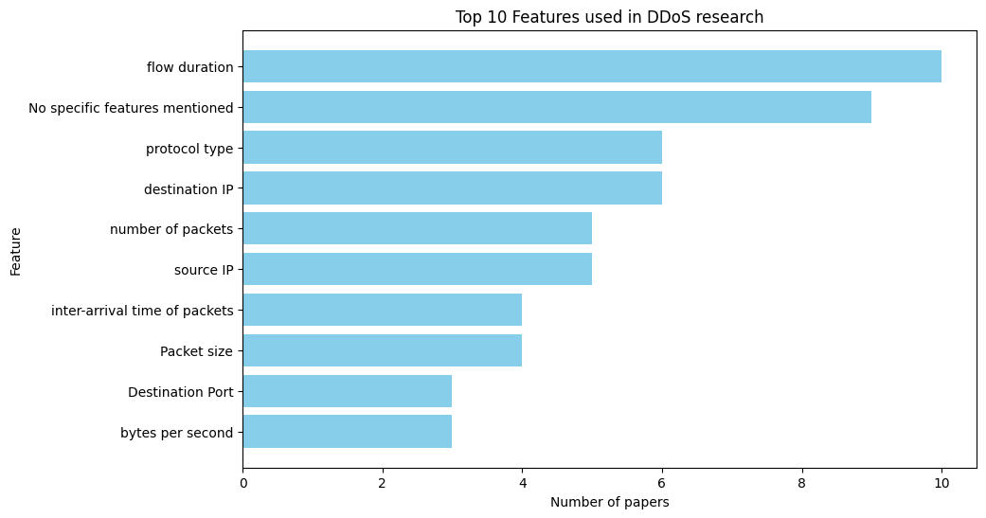
Top 10 features used in the literature.
Notes:
Random Forest, Logistic Regression, and MLP are among the most effective models for DDoS detection, achieving near-perfect accuracy.
Tuning parameters in models like Random Forest can significantly enhance performance.
XGBoost remains competitive, showing strong accuracy while being optimized for high performance.
Selecting the right algorithm depends on the dataset size, complexity, and computational constraints.

Slide 11
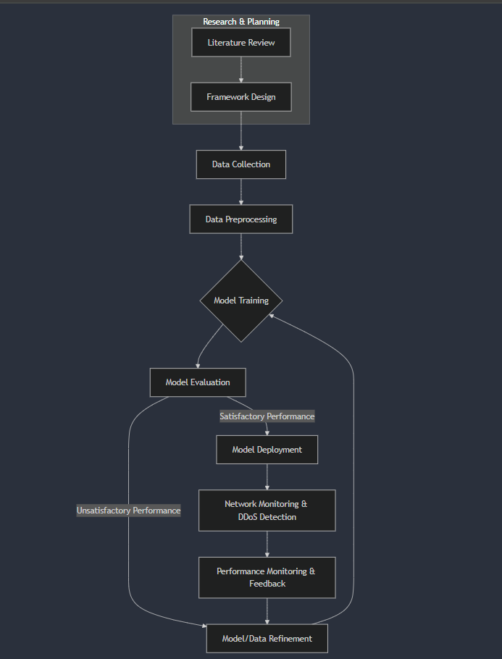
Methodology
Notes:
Random Forest, Logistic Regression, and MLP are among the most effective models for DDoS detection, achieving near-perfect accuracy.
Tuning parameters in models like Random Forest can significantly enhance performance.
XGBoost remains competitive, showing strong accuracy while being optimized for high performance.
Selecting the right algorithm depends on the dataset size, complexity, and computational constraints.

Slide 12

FINDINGS
Model performance is dependent on the dataset, environment
Machine learning and deep learning techniques are better
Hybrid models perform well.
Need to find model that works well with data imbalance
Model that can reduce false positive
Combining multiple deep learning models improves the performance

Slide 13
FINDINGS
Found that DDoS attack can be of 3 types - Volume based, protocol-based, or application-layer attacks
Hyperparameter tuning significantly improves the performance of ML models
USML unsupervised machine learning showed the best performance in distinguishing between Botnet and normal network traffic with high accuracy and low false alarm rates.
Overall, we need to work on the detection of real time traffic data for real time threat response
Need to test these models in diverse datasets

Slide 14

Conclusion
Choosing the right algorithm is crucial in mitigating DDoS attacks effectively.
Hyperparameter tuning enhances model performance, as seen with Random Forest after optimization.
Deep learning models (MLP) can improve detection but require more resources, making model selection dependent on the available infrastructure.
A combination of traditional ML and deep learning approaches can provide a robust defense against evolving DDoS threats.
Future research should focus on hybrid models and real-time implementations to further enhance DDoS detection capabilities in network security.
Notes:
Major key findings:
Working on diverse datasets to study the algorithms
Study the Hybrid models with different optimization, feature selection and hyperparameter tuning techniques
Real time traffic analysis for real time threat response. Most of the papers suggested to study this part of the field.
Reducing false positives.

